Slide 1
Java Architecture
Java Architecture is a collection of components, i.e., JDK, JRE, and JVM. It integrates the process of interpretation and compilation. It defines all the processes involved in creating a Java program. Java Architecture explains each and every step of how a program is compiled and executed.

Slide 2
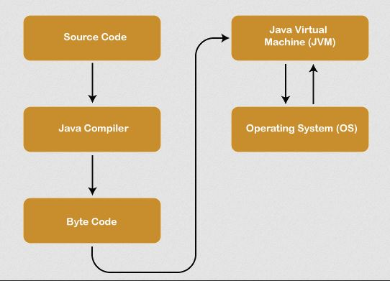
Java Architecture can be explained by using the following steps: There is a process of compilation and interpretation in Java. Java compiler converts the Java code into byte code. After that, the JVM converts the byte code into machine code. The machine code is then executed by the machine.

Slide 3
Components of Java Architecture
The Java architecture includes the three main components:
Java Virtual Machine (JVM) Java Runtime Environment (JRE) Java Development Kit (JDK)

Slide 4
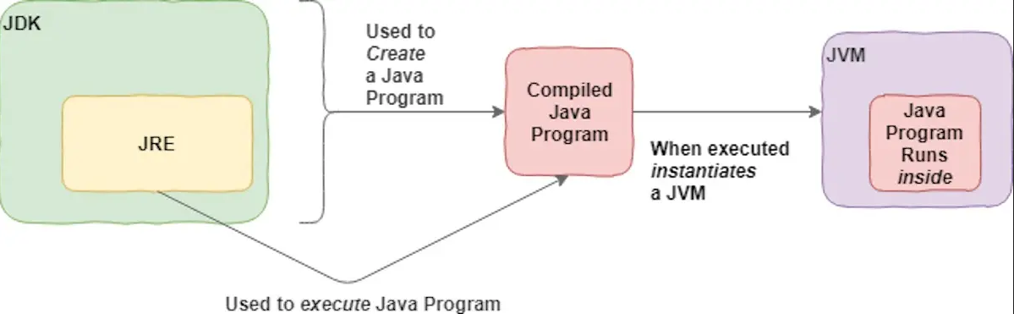
Java Development Kit
It is a software development environment used in the development of Java applications and applets. Java Development Kit holds JRE, a compiler, an interpreter or loader, and several development tools in it.

Slide 5
Java Runtime Environment
It provides an environment in which Java programs are executed. JRE takes our Java code, integrates it with the required libraries, and then starts the JVM to execute it.

Slide 6
Java Virtual Machine
The main feature of Java is WORA. WORA stands for Write Once Run Anywhere. The feature states that we can write our code once and use it anywhere or on any operating system. Our Java program can run any of the platforms only because of the Java Virtual Machine. It is a Java platform component that gives us an environment to execute java programs. JVM's main task is to convert byte code into machine code.
JVM, first of all, loads the code into memory and verifies it. After that, it executes the code and provides a runtime environment.

Slide 7
These are three main components of Java Architecture. The execution of a program is done with all these three components.
THANK YOU
SOURCE: www.javatpoint.com

